Slide 1


How-to-use Guide
Made by: ECI Youth Projects Coordinator, Christine Lacayo
and ECI Intern, Ilka Vanessa-Vera

Slide 2
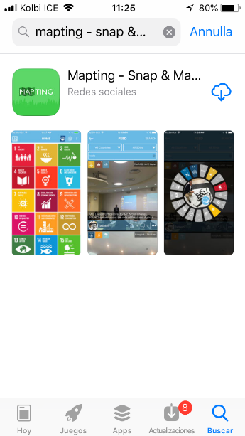
Download the App
In your app store, search:
“Mapting – Snap & Map”
This app is available for:
iOS & Playstore

Slide 3
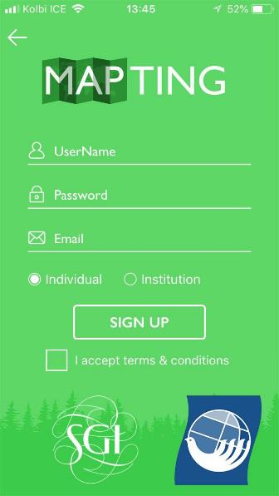
Create an Account
Create an account
Choose a username and password
Sign up as an individual or as an institution.
Save your password in a safe place

Slide 4
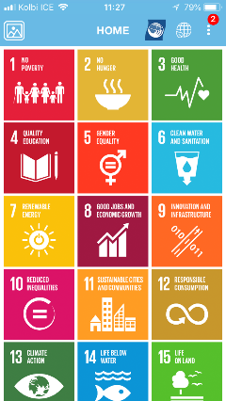
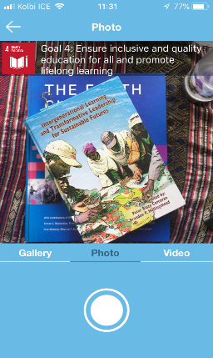
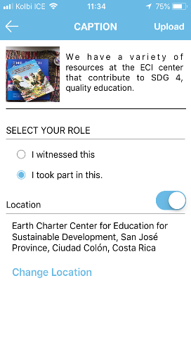
Choose an SDG
There are 17 SDGs on your home screen.
Choose the SDG you are working with or observing.
Take a picture or record a video that fits the description of the SDG you chose.
You can also choose from the Gallery.
Write a caption for your post, and how it relates to the SDG.
Select your role and your location to upload.

Slide 5
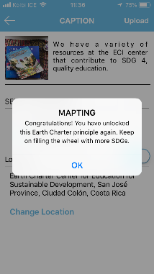
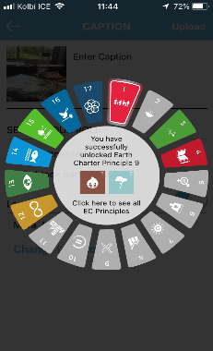
ECI Principles to SDGs
If it is your first time using this SDG, you will see your SDG wheel colored in with the SDGs you have used.
You can also click on the Earth Charter Principle icons connected to the SDG you used to read more about those ECI principles.
As you upload a post, you will unlock Earth Charter Principles.
If you have already used this SDG, you can click ‘OK' and then you will be taken to the Global map.

Slide 6
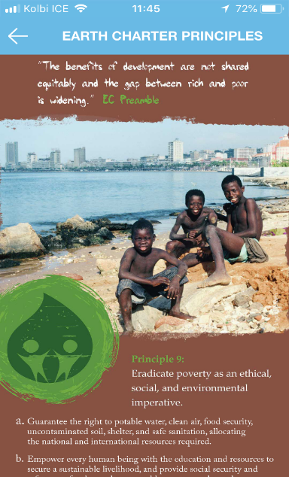
Earth Charter Principles
After clicking on the ECI icon, you will be taken to read more about that Earth Charter principle
Click the back arrow to go back to the SDG Wheel and to click on the other ECI principle

Slide 7
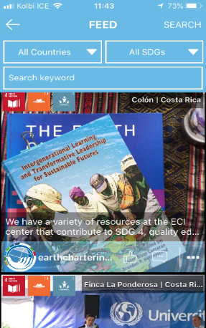
Photo Feed
Click on the photo feed icon to view your recently uploaded picture
Scroll through the photo feed to view other pictures people have uploaded
Search by country, SDG, or Keyword
Click on the thumbs up to like the picture or the chat icon to make a comment
Click on the three dots to share image on Facebook or Whatsapp.

Slide 8
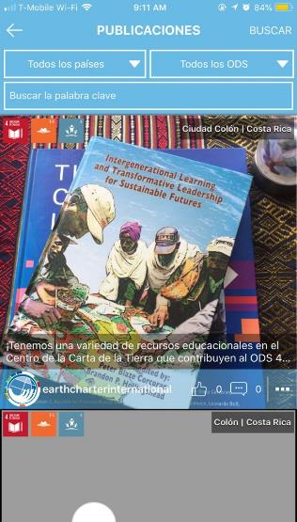
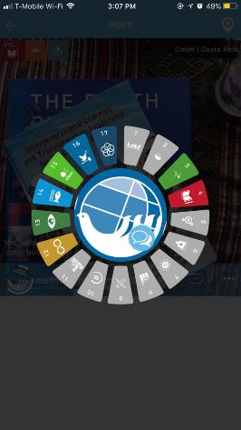
Photo feed
Click on the user’s SDG Wheel to view their SDGs used
Click on the chat icon to send a direct message to that user

Slide 9
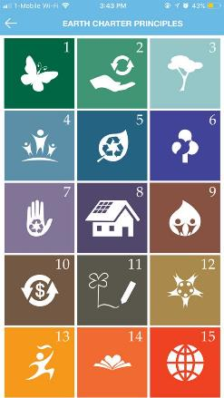
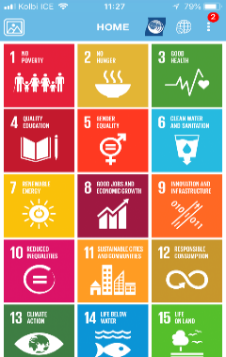
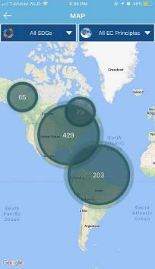
ECI Principles &
Global Map
Click on the Earth Charter logo to learn more about the Earth Charter principles
Click on the Global Map icon to view all posts mapped around the world

Slide 10
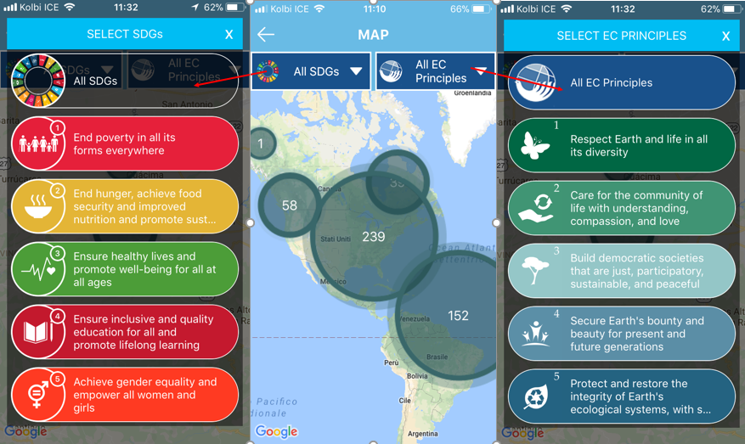
Global Map
Filter posts by SDG or by ECI principle

Slide 11
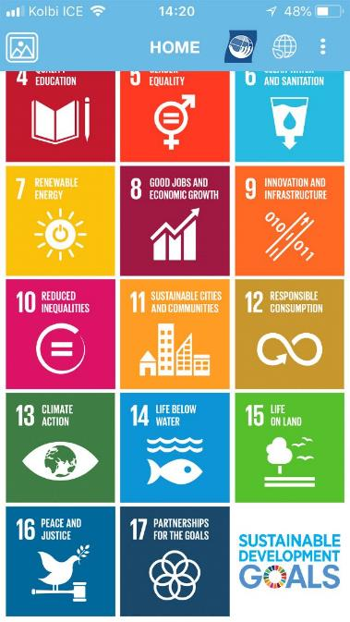
SDGs
Click on the SDG icon to learn more about the SDGs.

Slide 12
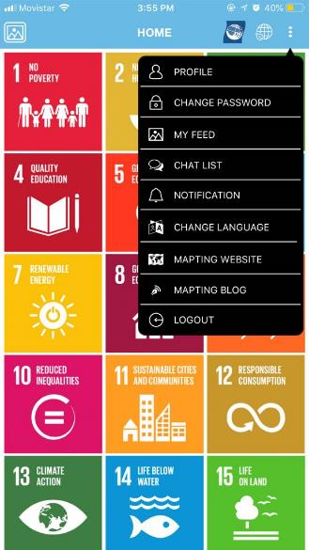
More settings
Profile
Change your password
View your feed/ posts
Chat List- view your chats
Notification
Change Language to Spanish
Mapting Website
Mapting Blog
Logout

Slide 13
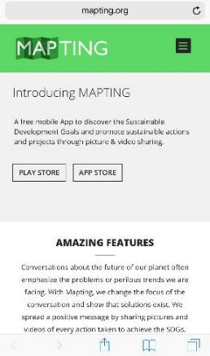
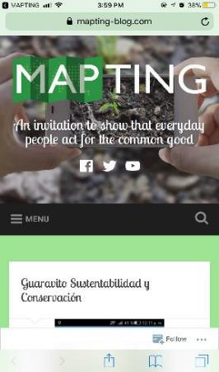
Learn more about
Mapting
MAPTING website
MAPTING blog

Slide 14
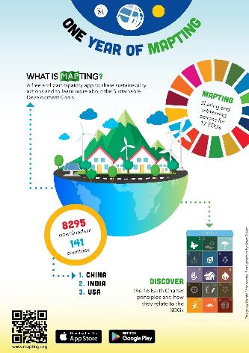
Want to get involved?
Send us an article talking about your experience using MAPTING and we will publish it on our Mapting blog!
Contact ECI Youth Coordinator: Youthcoordinator@earthcharter.org
Visit our page for more Information: www.earthcharter.org/Mapting

Slide 15

Still Confused?
Click on the image to learn more about how to use MAPTING.
Notes:
Click on the image to learn more about how to use MAPTING.

